Slide 1
Algorithms and Problem Solving
Design and Analysis of Algorithms
UNIT NO. I

Slide 2
Content
01.
04.
07.
10.
What are Algorithms?
Design of algorithm
Iterative algorithm design issues
Classification of time complexities
02.
05.
08.
Algorithm as Technology
Need of correctness of algorithm
Classification of problem
03.
06.
09.
Evolution of Algorithm
Confirmimg correctness of algorithm
Problem solving strategies

Slide 3
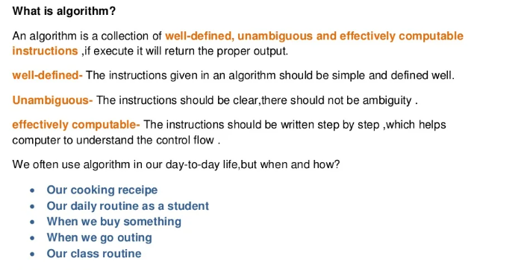

Slide 4
Algorithms as a Technology
Suppose computers were infinitely fast and computer memory was free. Would you have any reason to study algorithms? The answer is yes, if for no other reason than that you would still like to demonstrate that your solution method terminates and does so with the correct answer.
If computers were infinitely fast, any correct method for solving a problem would do. You would probably want your implementation to be within the bounds of good software engineering practice (i.e., well designed and documented), but you would most often use whichever method was the easiest to implement.

Slide 5
Of course, computers may be fast, but they are not infinitely fast. And memory may be cheap, but it is not free. Computing time is therefore a bounded resource, and so is space in memory. These resources should be used wisely, and algorithms that are efficient in terms of time or space will help you do so.

Slide 6
Evolution of Algorithm
Algorithms find their place in computer programs and mechanical applications. The origin of the term is attributed to Persian astronomer and mathematician, Abu Abdullah Muhammad ibn Musa Al-Khwarizmi. His works included introducing the decimal positioning within numeric systems, along with the solution of linear and quadratic equations.
In its original form, algorithms gave base to the algebra of logic, using variables in calculations. The earliest instances of algorithms include Euclid’s function of greatest common divisor in numerics, Archimedes’ approximation of Pi, and Eratosthenes’ calculation of prime numbers.
However, the first person to use the initial form of the term algorithm was 12th century English philosopher, Adelard de Bath, who used the term algorismus when translating Al-Khwarizmi’s Arabic works.

Slide 7
Design of an Algorithm
Algorithms are normally written as a flowchart or in pseudocode.
When designing an algorithm, consider if there is more than one way of solving the problem.
When designing an algorithm there are two main areas to look at:
the big picture - What is the final goal?
the individual stages – What hurdles need to be overcome on the way to the goal?
Understanding the problem
1.What are the inputs into the problem?
2.What will be the outputs of the problem?
3.In what order do instructions need to be carried out?
4.What decisions need to be made in the problem?
5.Are any areas of the problem repeated?
Once these basic things are understood, it is time to design the algorithm.

Slide 8
Pseudocode:
Pseudocode is not a programming language, it is a simple way of describing a set of instructions that does not have to use specific syntax.
Common pseudocode notation:
There is no strict set of standard notations for pseudocode, but some of the most widely recognised are:
1.INPUT – indicates a user will be inputting something
2.OUTPUT – indicates that an output will appear on the screen
3.WHILE – a loop (iteration that has a condition at the beginning)
4.FOR – a counting loop (iteration)
5.REPEAT – UNTIL – a loop (iteration) that has a condition at the end
6.IF – THEN – ELSE – a decision (selection) in which a choice is made
any instructions that occur inside a selection or
iteration are usually indented

Slide 9
Example:
Pseudocode can be used to plan out programs. Planning a program that asks people what the best subject they take is, would look like this in pseudocode:
REPEAT
OUTPUT 'What is the best subject you take?'
INPUT user inputs the best subject they take
STORE the user's input in the answer variable
IF answer = 'Computer Science' THEN
OUTPUT 'Of course it is!'
ELSE
OUTPUT 'Try again!'
UNTIL answer = 'Computer Science'

Slide 10
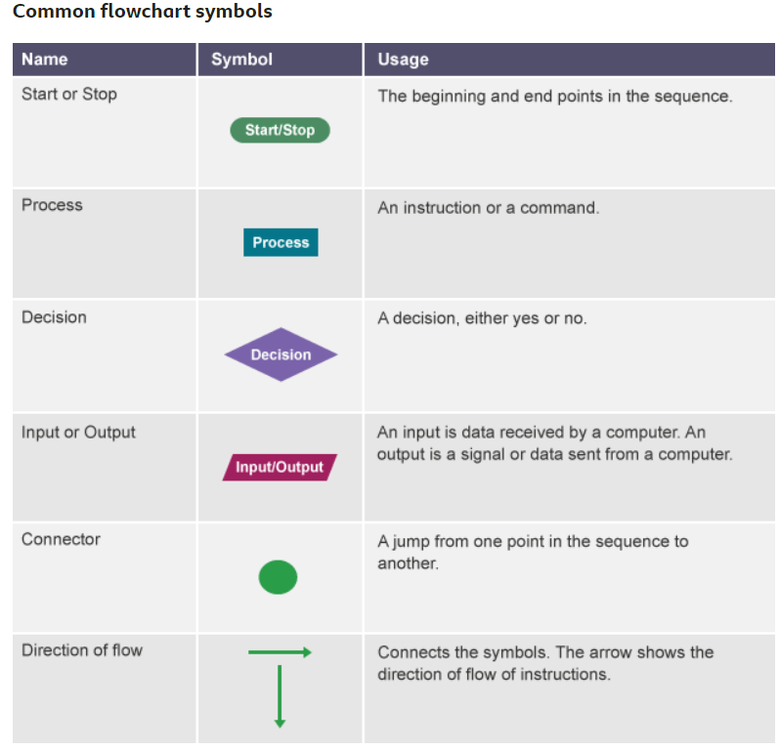
2. Flowcharts: A flowchart is a diagram that represents a set of instructions. Flowcharts normally use standard symbols to represent the different types of instructions. These symbols are used to construct the flowchart and show the step-by-step solution to the problem.

Slide 11
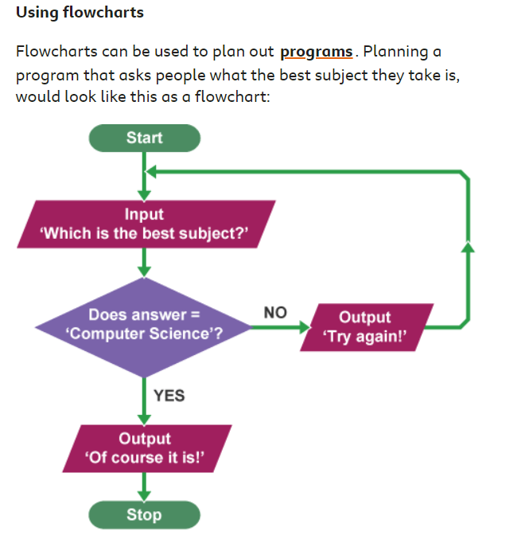
Example:

Slide 12
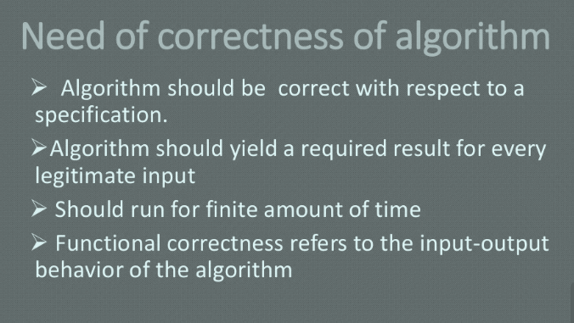



Slide 13
Need of Correctness of an Algorithm
For many problems, algorithms are very complex. Reliability of an algorithm cannot be claimed unless and until it gives the correct output for each of the valid inputs.
Tracing the output of each possible input is impossible. The correctness of an algorithm can be quickly proved by checking certain conditions.
Programming languages are an effective means of implementing complicated packages and applications. Complex systems, such as banking and e-commerce, are complex to design and evaluate, and are frequently incorrect. Much has been said regarding the creation of an effective tool for developing dependable software.
We consider a software to be “right” if it performs precisely what the programmer and user want it to do. Algorithm must go through all possible input scenarios to determine whether or not it is giving the proper output.

Slide 14


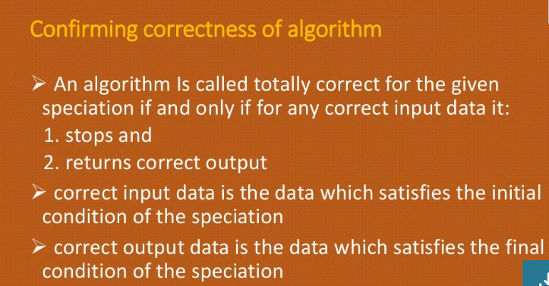

Slide 15
Confirming Correctness of an Algorithm
The well-defined computational problem is a triplet of P (I, O, R) such that I is the valid input set, O is the accepted output set, and R defines the relationship between I and O. R can be considered as a mapping function, which translates I to R. Let i Є I is a problem instance.
The algorithm to solve problem P is correct if and only if for all the problem instance i Є I, it terminates and produces correct output o Є O, i.e. (i, o) Є R.
However, a testing algorithm for all inputs is not possible, or it may take too much of time. Let the algorithm consists of a series of n steps.
One way to prove the correctness of the algorithm is to check the condition before (precondition) and after (postcondition) the execution of each step.
The algorithm is correct only if the precondition is true then postcondition must be true.

Slide 16
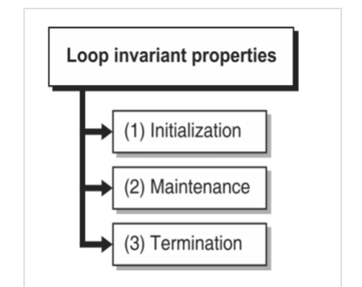
The correctness of such algorithm is proved through loop invariant property. It involves three steps:
Correctness of Algorithm:
Steps to prove loop invariant property

Slide 17
1. Initialization: Conditions true before the first iteration of the loop
2. Maintenance: If the condition is true before the loop, it must be true
before the next iteration.
3.Termination: On termination of the loop, invariant gives us a useful
property that helps us to prove the correctness of the algorithm.
Correctness does not involve analysis of the algorithm.

Slide 18
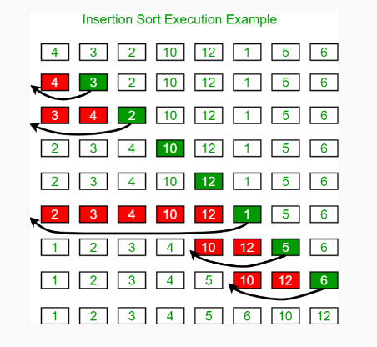

Slide 19
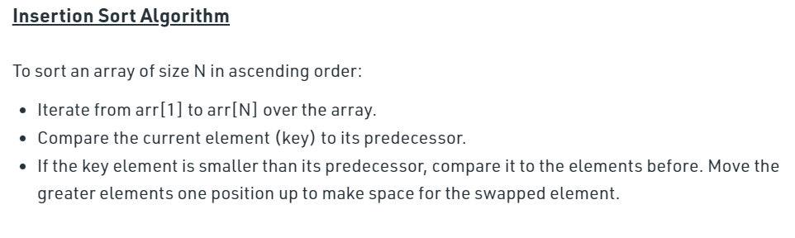

Slide 20
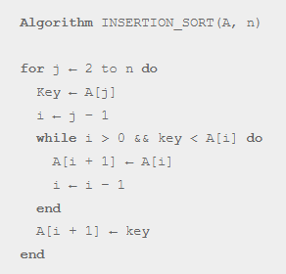
Example to prove the correctness of Insertion sort:
First, j cards are always sorted in array A[1…j – 1]. Remaining A[j…n] cards are unsorted.
Initialization: The loop invariant holds before initialization. For j = 2, subarray A[1…j – 1] contains only one element, i.e. A[1]. This is a trivial case of sorting. It proves that the loop invariant is true before the first iteration.
Maintenance: In each iteration, the algorithm finds the correct position of the key to insert the element A[j] by moving A[j – 1], A[j – 2],.. elements. After the loop, A[j] element will be inserted to the correct position. After the loop, A[1…j] contains elements the same as in A[1…j] before the loop, but now they will be in sorted order. Thus the invariant is hold in attendance too.

Slide 21
Termination:
The loop terminates when j = n. Each iteration inserts A[j] on the correct location, so after n iteration, all elements will be in their right position. After the loop, A[1…n] contains elements the same as in A[1…n] before the loop, but now they will be in sorted order.

Slide 22
Problem Solving Principles
A computational problem generally consists of two parts. First, it needs an input description, such as “a sequence of integers”, “a string”, or some other kind of mathematical object.
Using this input, we have a goal which we wish to accomplish defined by an output description.
For example, a computational problem might require to sort a given sequence of integers. This particular problem is called the “Sorting Problem”.

Slide 23
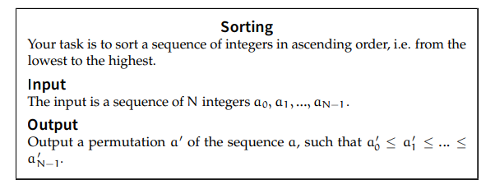
Sorting Problem Example:

Slide 24
Classification of Problems
One important step in this process is defining the type of the problem and classify it. This step leads us to know whether the problem we are trying to solve is solvable or not before going further into the development process.
Complexity theory is a subfield of computer science that deals with classifying problems into a set of categories that specify the solvability of these problems.
1. P-Problems
2.NP-Problems
3.Solvable Problems
4.Deterministic & Non-Deterministic Problems

Slide 25

P-Problems:
Let’s assume that you’re sitting with your friend, and you’re both hungry. You suggest going out for pizza, but your friend isn’t feeling pizza today. So, they suggest to go for sushi, but you can’t handle raw fish. That goes on for a while, and you’re both getting hungrier.
Eventually, you say, “let's go with the most convenient option.” That is the closest one to where you are. You start sorting the top options based on their distance from your current location.
This problem can be described mathematically using an equation like Y(time to get to the restaurant) = 10 X( the distance to the resultant). Where 10 is the number of minutes you need to walk 1 km. This type of equation in math is called a polynomial.

Slide 26
NP-Problems:
Let’s take our problem up a notch. Now, it’s not just you and your friend; your parents and siblings are joining you for dinner as well. You can still follow the same approach you did when there were only two people and go to the nearest place, or you can think of better solutions.
You ask each one to say what they want to eat and try to convince others to choose the same thing. In the P solution, each person chose one place, and then the nearest one was the winner.
But, now, each will have to make more than one decision, each will have to choose a place and make a decision about the other’s suggestions.
This solution now got more complex. To describe it in math-terms, we would say Y(time needed to decide) = X² where X is the number of people we have. This now becomes an exponential (EXP) problem, and solving it will take longer than following the P approach.

Slide 27
Solvable Problems (R)
So far, despite how long it took us to decide what to eat, we eventually did decide and did eat. Both approaches to decide eventually led to a solution. That’s what solvable problems are. R problems are problems that can be solved in finite time. Whether the time is seconds, hours, or days, as long as it’s finite, then the problem is solvable.
You might be wondering now, is there a problem that would take an infinite time to solve?
The answer is yes—the halting problem. The problem statement goes, “Can we design a general algorithm that decides if a given program will halt or not if given a specific input?”. The term general makes this problem unsolvable because we can’t generalize when a program will halt or not unless we try and see if it does.
This problem is called undecidable and hence, unsolvable in infinite time. The halting problem is not the only undecidable problem in computer science; you can find more problems here.

Slide 28
Deterministic and Nondeterministic Problems:
When we write code to solve a specific problem, we often do so in a deterministic way. We write a series of loops, conditional statements to get us to where we want to go. Another approach to solve problems is doing so in a nondeterministic way.
In a nondeterministic way, we solve problems by asking questions and/ or making guesses until we reach the desired answer.
Going back to our eating dilemma, let’s say, instead of sorting options based on their relative distance to us, or having each person debate and justify their choice, you decide to write the options down and let your cat decide which the winner. So, you set the papers in front of the cat and wait for it to place its paw on one of them.
Following this approach, you managed to solve the problem nondeteminstacally. This type of solution takes P type problems and solves them faster with a magical nondeterministic approach. These types of problems are classified as NP.

Slide 29
NP-hard vs. NP-complete:
Any NP problem that can be solved in P time nondeterministically is called an NP-complete problem as long as it is a decision problem. NP-hard is the next level. NP-hard problems can be reduced to NP-complete in P time and are not decision problems such as the halting problem.

Slide 30
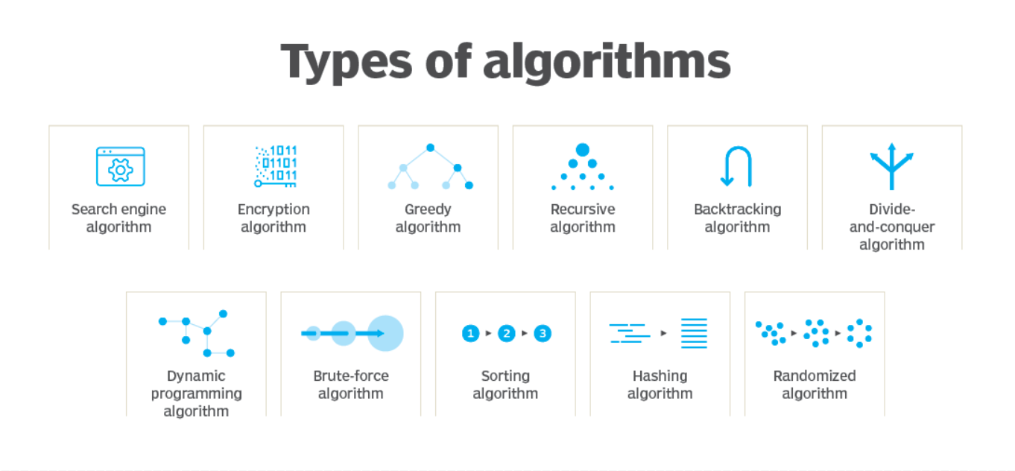
Problem Solving Strategies

Slide 31
There are several problem solving strategies, all designed to accomplish different tasks. For example, algorithms perform the following:
Search engine algorithm- This algorithm takes search strings of keywords and operators as input, searches its associated database for relevant webpages and returns results.
Encryption algorithm-This computing algorithm transforms data according to specified actions to protect it. A symmetric key algorithm, such as the Data Encryption Standard, for example, uses the same key to encrypt and decrypt data. As long as the algorithm is sufficiently sophisticated, no one lacking the key can decrypt the data.
Greedy algorithm-This algorithm solves optimization problems by finding the locally optimal solution, hoping it is the optimal solution at the global level. However, it does not guarantee the most optimal solution.
Recursive algorithm- This algorithm calls itself repeatedly until it solves a problem. Recursive algorithms call themselves with a smaller value every time a recursive function is invoked.

Slide 32
Backtracking algorithm- This algorithm finds a solution to a given problem in incremental approaches and solves it one piece at a time.
Divide-and-conquer algorithm- This common algorithm is divided into two parts. One part divides a problem into smaller subproblems. The second part solves these problems and then combines them together to produce a solution.
Dynamic programming algorithm- This algorithm solves problems by dividing them into subproblems. The results are then stored to be applied for future corresponding problems.Example: A fibonacci series is the sequence of numbers in which each number is the sum of the two preceding ones. For example, 0,1,1, 2, 3 . Here, each number is the sum of the two preceding numbers.
Brute-force algorithm- This algorithm iterates all possible solutions to a problem blindly, searching for one or more solutions to a function.

Slide 33
Sorting algorithm: Sorting algorithms are used to rearrange data structure based on a comparison operator, which is used to decide a new order for data.
Hashing algorithm- This algorithm takes data and converts it into a uniform message with a hashing
Randomized algorithm- This algorithm reduces running times and time-based complexities. It uses random elements as part of its logic.

Slide 34
What is Time Complexity?
The Time Complexity is the amount of time taken by an algorithm to run, as a function of the length of the input. Here, the length of input indicates the number of operations to be performed by the algorithm.
Time complexity measures the time taken to execute each statement of code in an algorithm. If a statement is set to execute repeatedly then the number of times that statement gets executed is equal to N multiplied by the time required to run that function each time.
Complexity Classification:
Constant time – O (1)
Linear time – O(n)
Logarithmic time – O (log n)
Quadratic time – O (n^2)

Slide 35
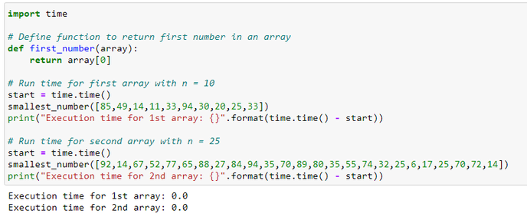
1. Constant time – O (1)
An algorithm is said to have constant time with order O (1) when it is not dependent on the input size n. Irrespective of the input size n, the runtime will always be the same.
Example as shown:

Slide 36
The above code shows that irrespective of the length of the array (n), the runtime to get the first element in an array of any length is the same. If the run time is considered as 1 unit of time, then it takes only 1 unit of time to run both the arrays, irrespective of length. Thus, the function comes under constant time with order O (1).

Slide 37
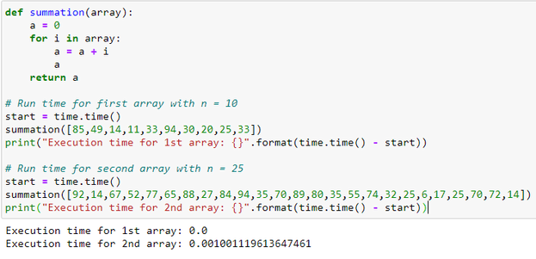
2. Linear time – O(n)
An algorithm is said to have a linear time complexity when the running time increases linearly with the length of the input. When the function involves checking all the values in input data, such function has Time complexity with this order O(n).
For example:

Slide 38
The above code shows that based on the length of the array (n), the run time will get linearly increased. If the run time is considered as 1 unit of time, then it takes only n times 1 unit of time to run the array. Thus, the function runs linearly with input size and this comes with order O(n).

Slide 39
3. Logarithmic time – O (log n):
An algorithm is said to have a logarithmic time complexity when it reduces the size of the input data in each step. This indicates that the number of operations is not the same as the input size. The number of operations gets reduced as the input size increases.
Algorithms with Logarithmic time complexity are found in binary trees or binary search functions. This involves the search of a given value in an array by splitting the array into two and starting searching in one split. This ensures the operation is not done on every element of the data.

Slide 40
4. Quadratic time – O (n^2):
An algorithm is said to have a non – linear time complexity where the running time increases non-linearly (n^2) with the length of the input. Generally, nested loops come under this time complexity order where for one loop takes O(n) and if the function involves a loop within a loop, then it goes for O(n)*O(n) = O(n^2) order.
Similarly, if there are ‘m’ loops defined in the function, then the order is given by O (n ^ m), which are called polynomial time complexity functions.

Slide 41
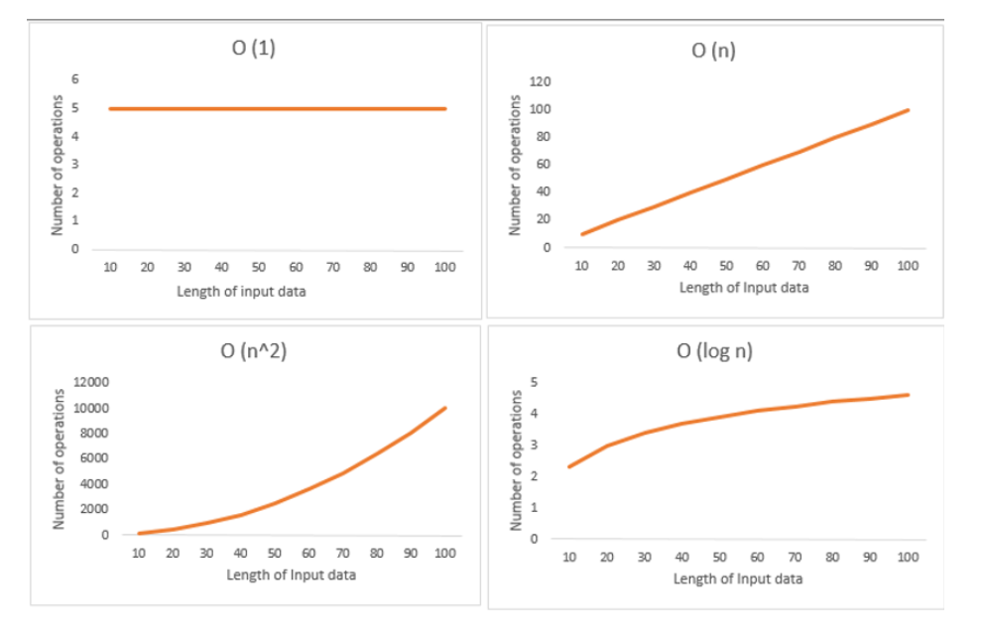
The order of growth for all time complexities are indicated in the graph below:

Slide 42
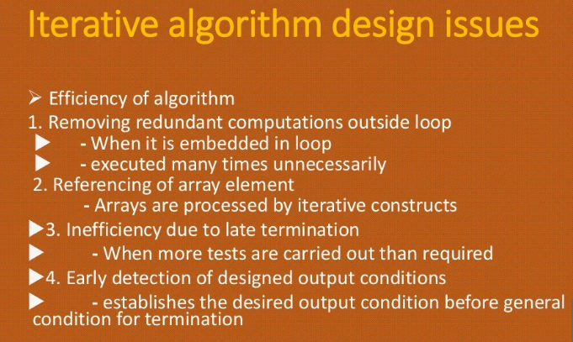

Slide 43
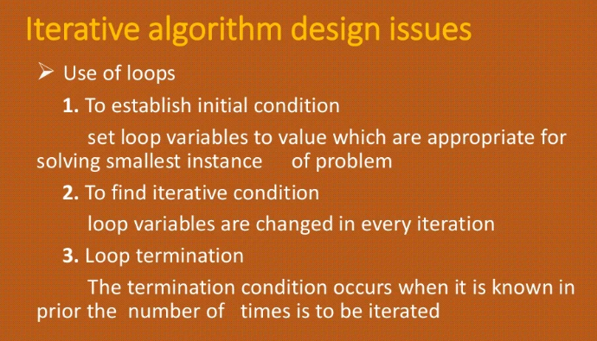

Slide 44
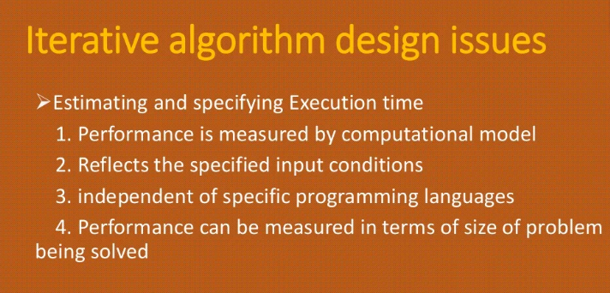

Slide 45

